Slide 1
CIS 490H/590J Edge Computing ML@Edge, Federated Learning
Winter 2023
Prof. Zheng Song zhesong@umich.edu

Slide 2
Outline
Brief introduction of machine learning
Executing ML tasks at Edge
Training ML models at Edge
Credit:
https://github.com/wangshusen/DeepLearning/tree/master/Slides https://inst.eecs.berkeley.edu/~cs294-163/fa19/slides/federated-learning.pdf

Slide 3

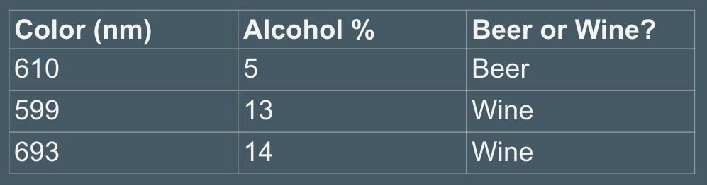
Basic Procedure of Machine Learning
Wine or Beer?
Based on two features: color (light wavelength) and alcohol content (percentage) Basic Steps:
1) Collecting data (buy all wines and beers available on the market)

Slide 4
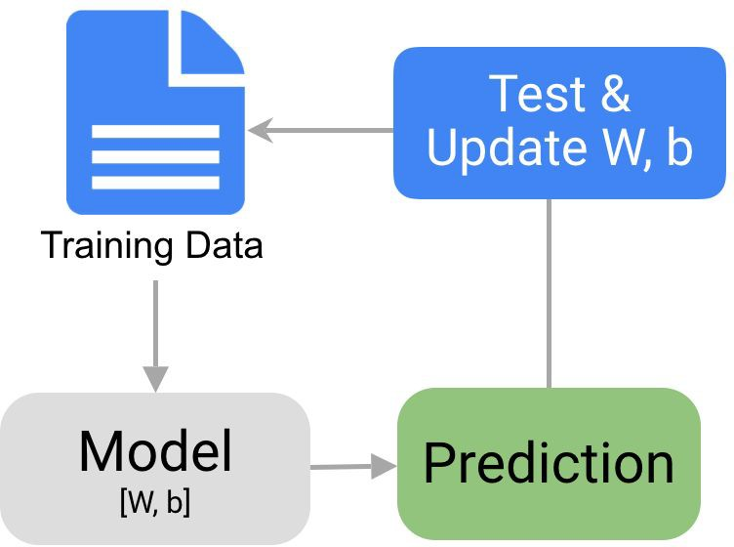
Basic Procedure of Machine Learning
Basic Steps:
2) Choose a model and training

Slide 5
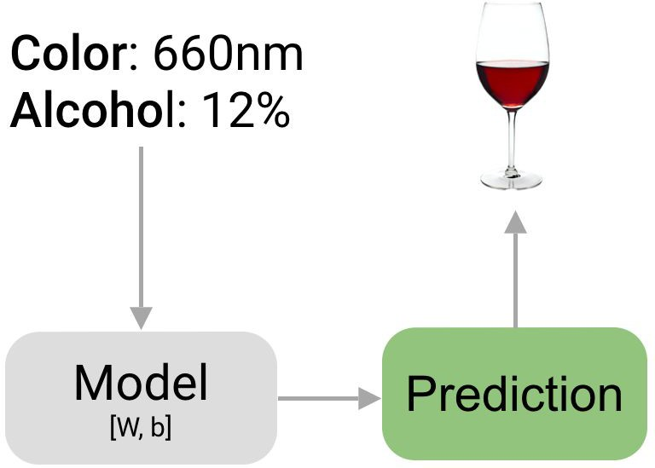
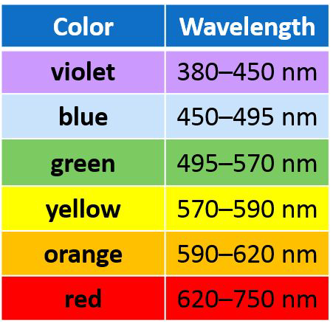
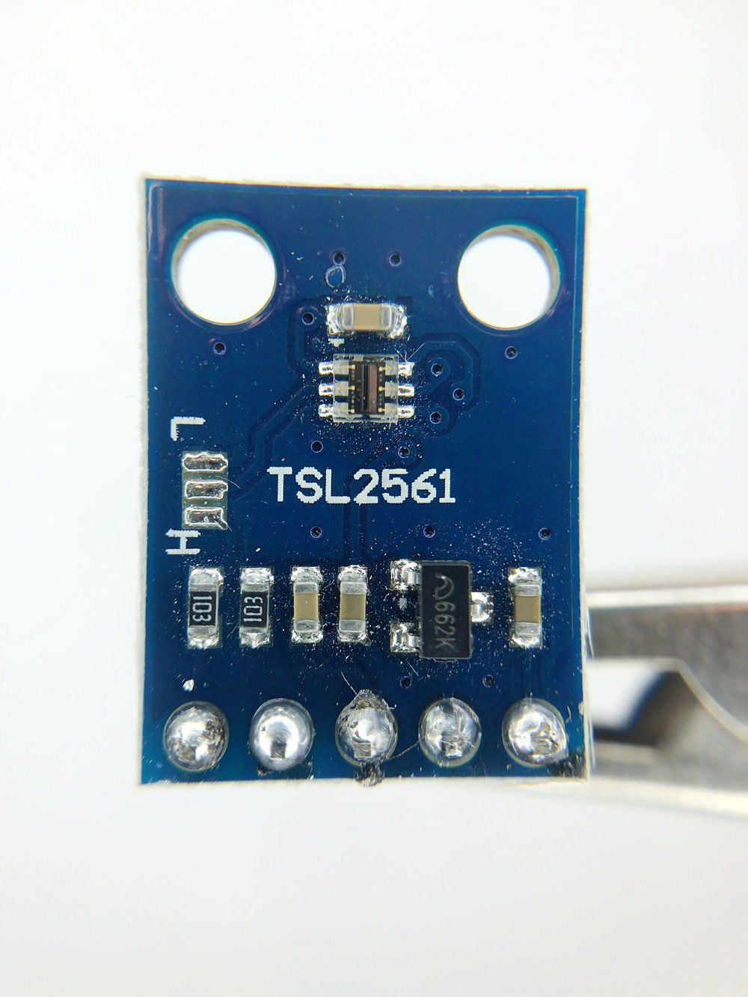
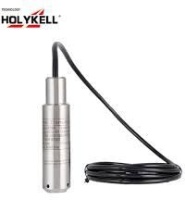
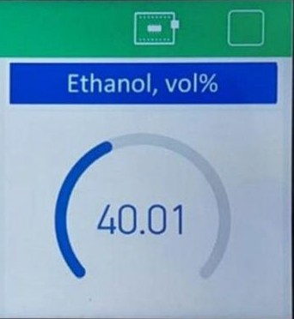
Basic Procedure of Machine Learning
Basic Steps:
3) Prediction
Ethanol sensor
Reference:
https://towardsdatascience.com/the-7-steps-of-machine-learning-2877d7e5548e

Slide 6
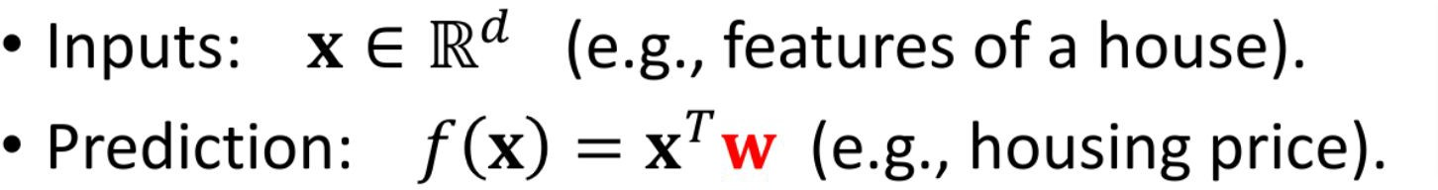
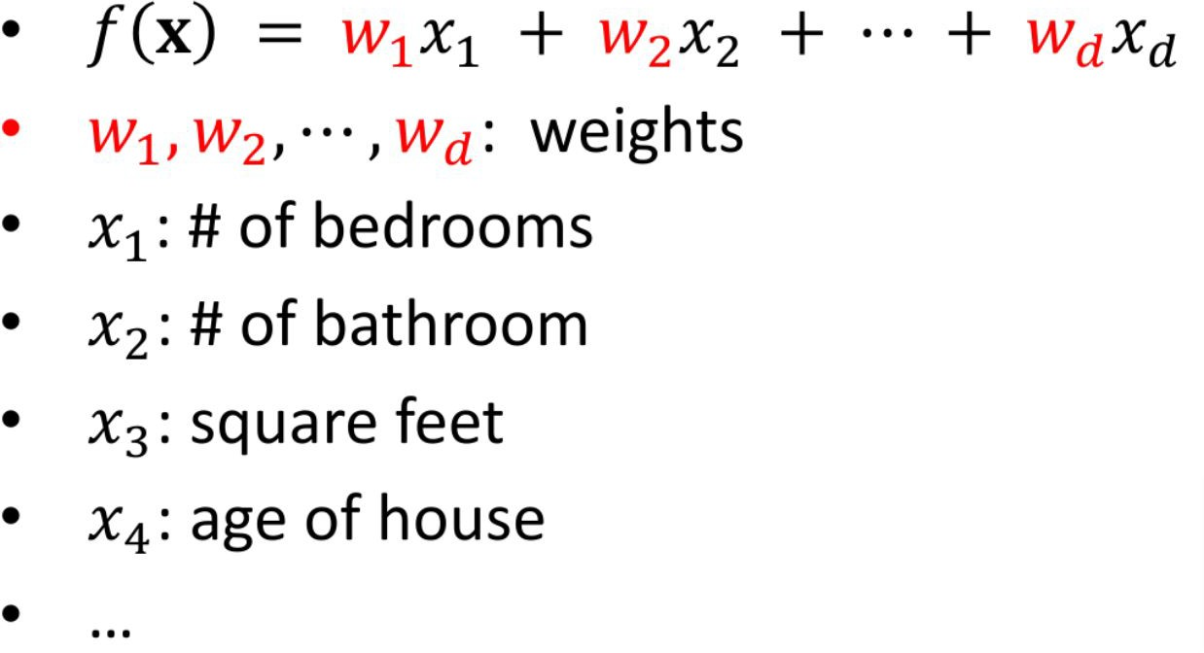
House Price Prediction by a Linear Predictor Model

Slide 7
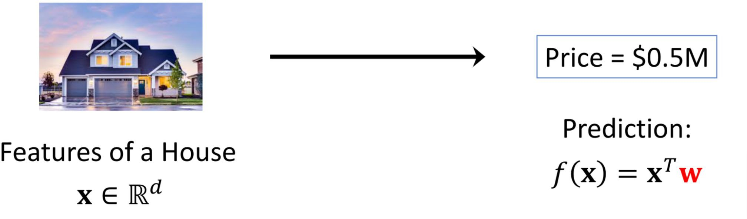
House Price Prediction by a Linear Predictor Model
Question: How to find W?

Slide 8
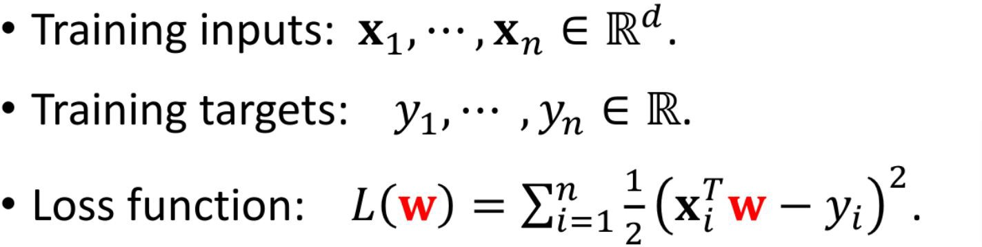
Linear Predictor Model
Question: How to find W?

Slide 9
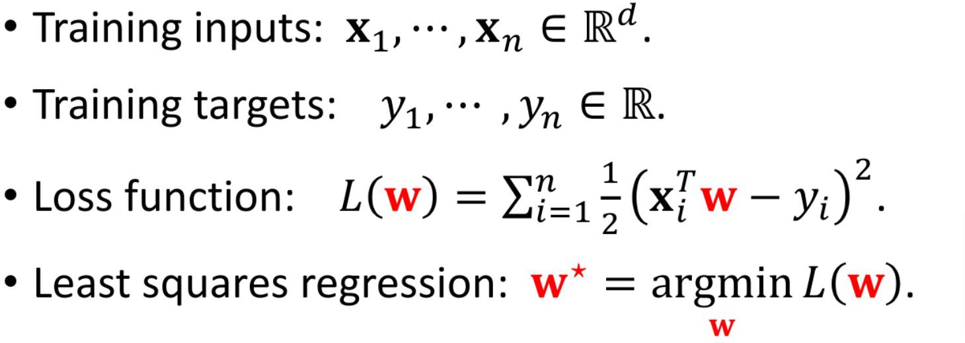
Linear Predictor Model
Question: How to find W?

Slide 10
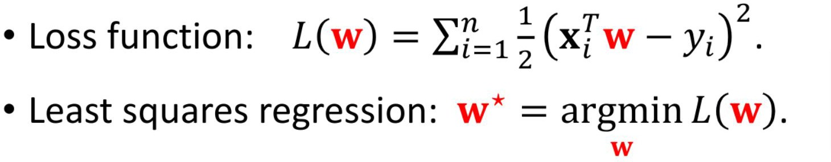
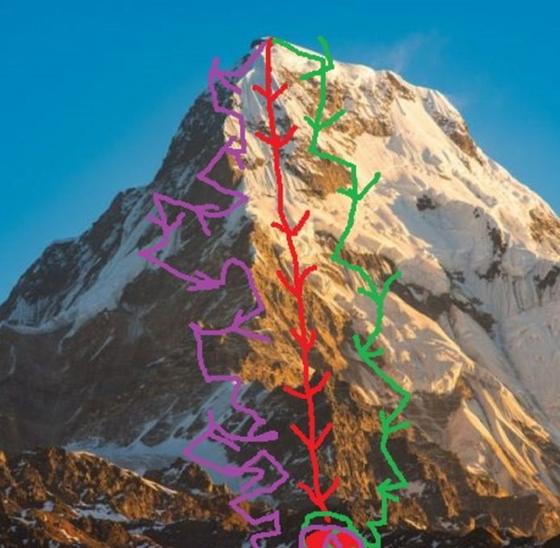
Solution: Gradient Descent (for Least Squares Regression)
the direction of greatest change of L(w)

Slide 11
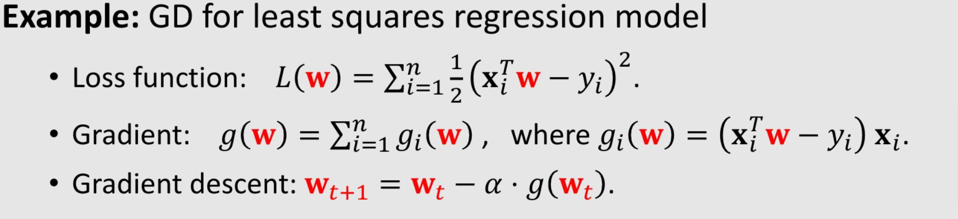
Solution: Gradient Descent (for Least Squares Regression)
\alhpa, learning rate (not too fast, not too slow)
When to stop? L(w) won’t change much at each step

Slide 12
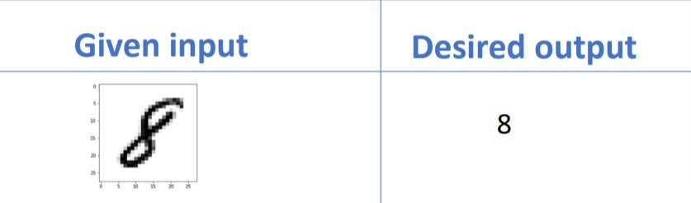
Another Example: Handwriting Recognition
y = f (x, w)
x: {0,1} for 30*30 matrix = BoolArray[900] y: {0, 1, 2, 3, 4, 5, 6, 7, 8, 9}

Slide 13
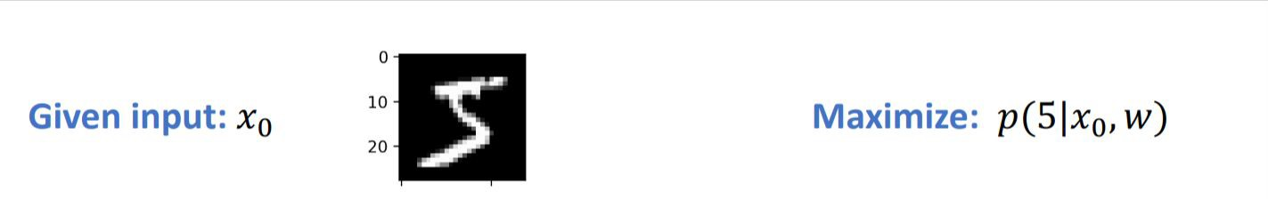
Training
Given one input sample pair (x0, y0), the goal of ML model training is to find a set of parameters w, to maximize the probability of outputting y0 given x0.

Slide 14
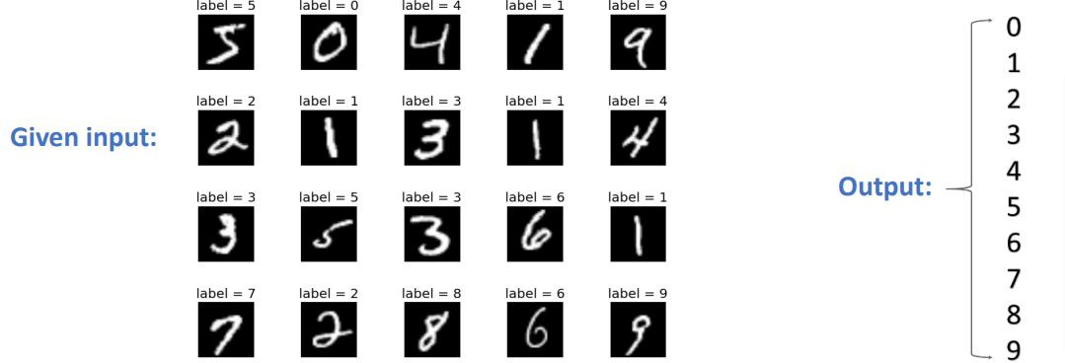
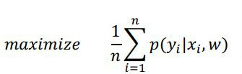
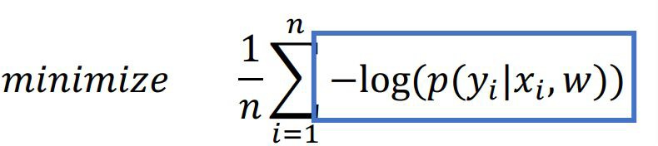
Training
Given a training dataset containing n input-output pairs (x_i, y_i, \forall i \in [1, n], find a set of parameter w, such that the average of p(y_i) is maximized given x_i

Slide 15
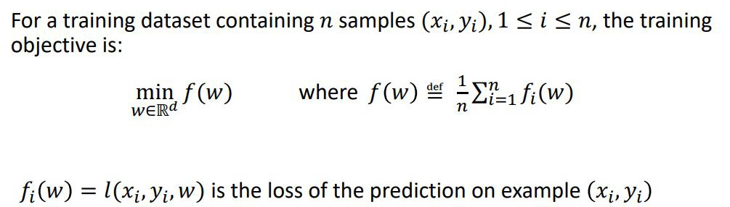
Training

Slide 16
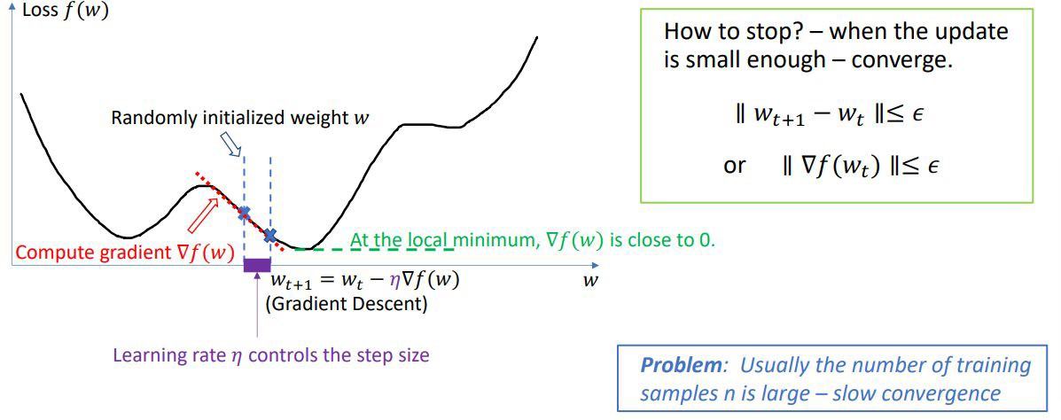
Training Solution: Gradient Descent

Slide 17
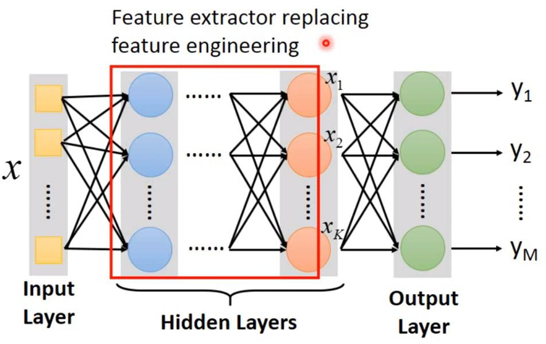
Deep Learning
More layers than traditional ML
Models are BIG: ResNet-50 has 25M parameters
Big Models are trained on big data, e.g., ImageNet has 14M images
Big Model + Big Data → Big Training Cost

Slide 18
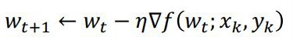
Training Solution: Stochastic Gradient Descent (SGD)
At each step of gradient descent, instead of compute for all training samples, randomly pick a small subset (mini-batch) of training samples (x_k, y_k)
Compared to gradient descent, SGD takes more steps to converge, but each step is much faster.

Slide 19
Outline
Brief introduction of machine learning
Executing ML tasks at Edge
Training ML models at Edge

Slide 20
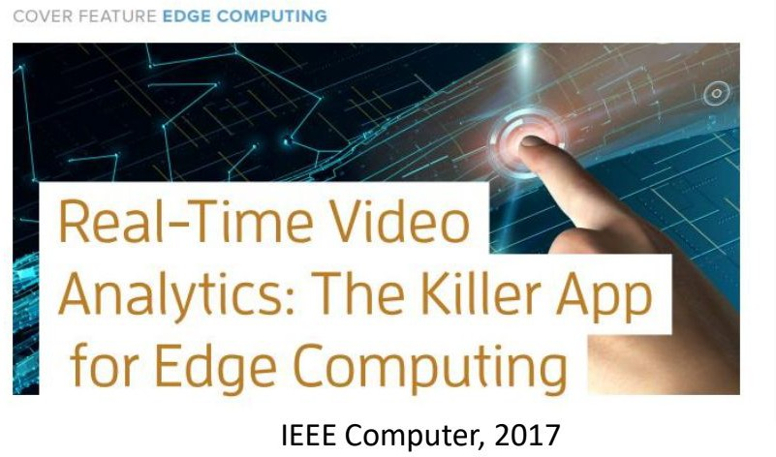
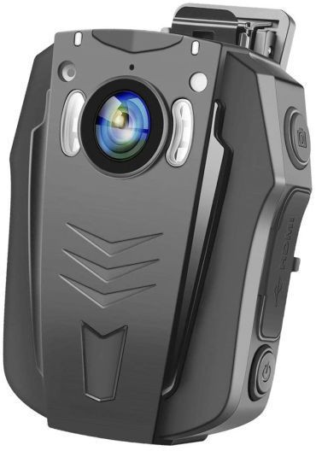
ML@Edge Applications
Usages
Computer Vision
Natural Language Processing
…
Wearable Camera

Slide 21
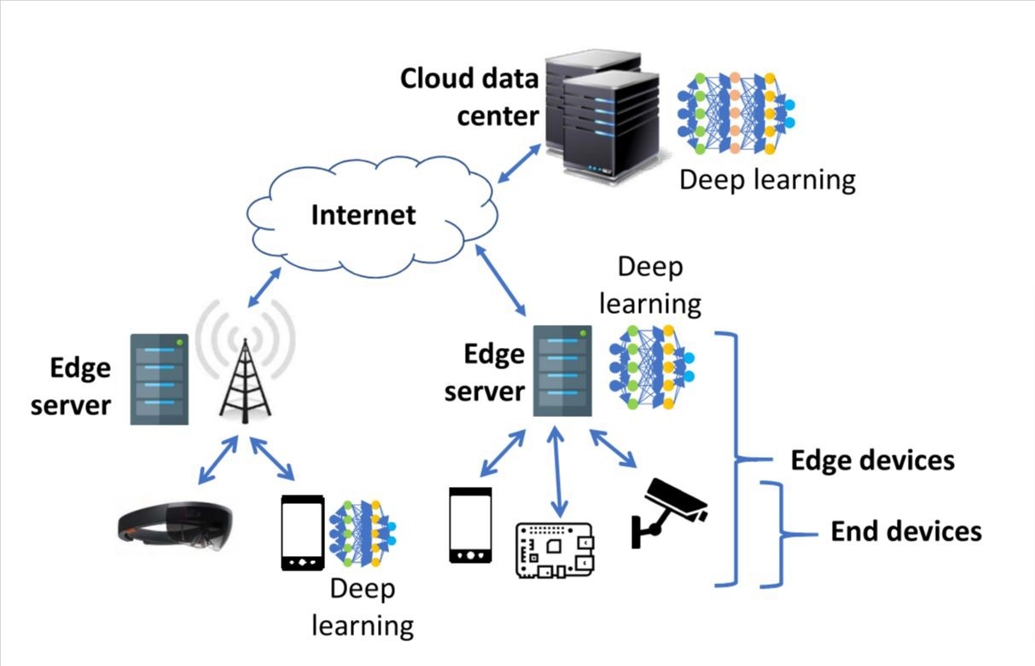
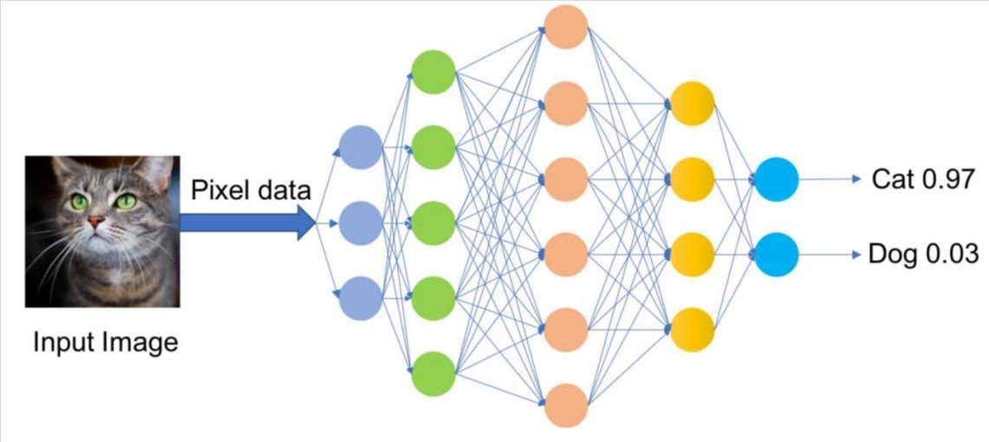
Executing ML Tasks @Edge
For latency, privacy reasons…

Slide 22
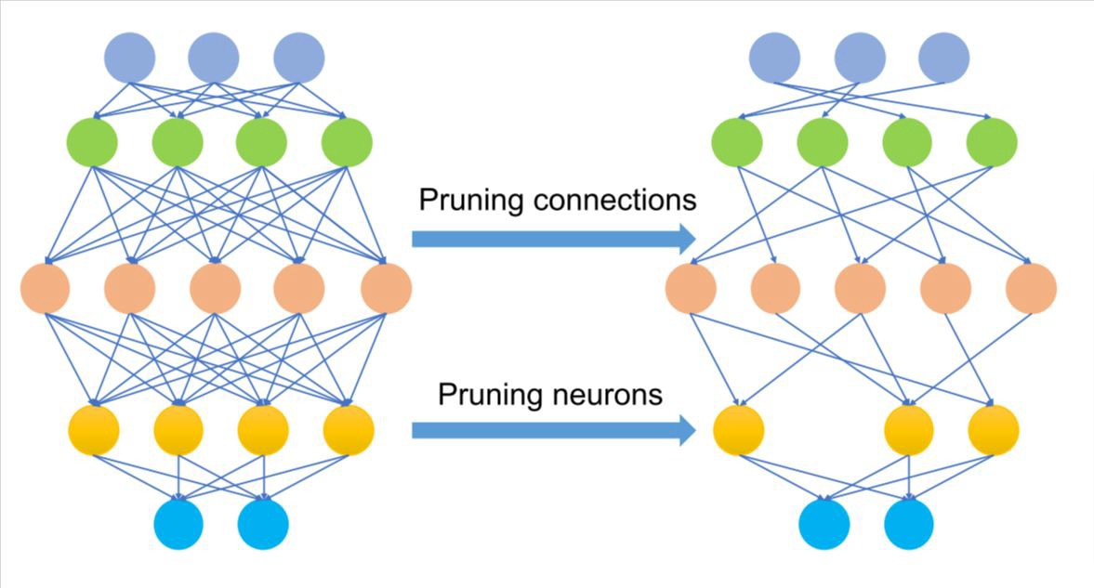
How to adapt ML for resource-constrained Edges?
Run ML on Mobile Edge Devices:
Simplify ML models: MobileNets, Yolo, SqueezeNet (e.g., decompose the convolution filter into two simpler operations)
Model Compression:
Parameter quantization: floating point parameters → low-bit width numbers
Pruning: removing the least important parameters
Hardware: Tensor processing Unit

Slide 23
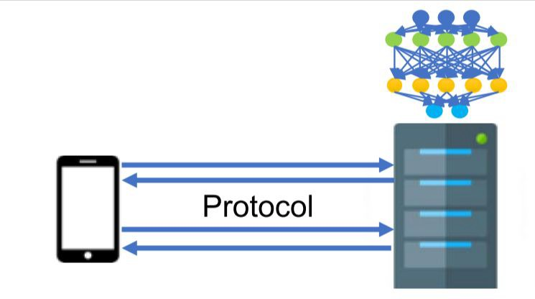
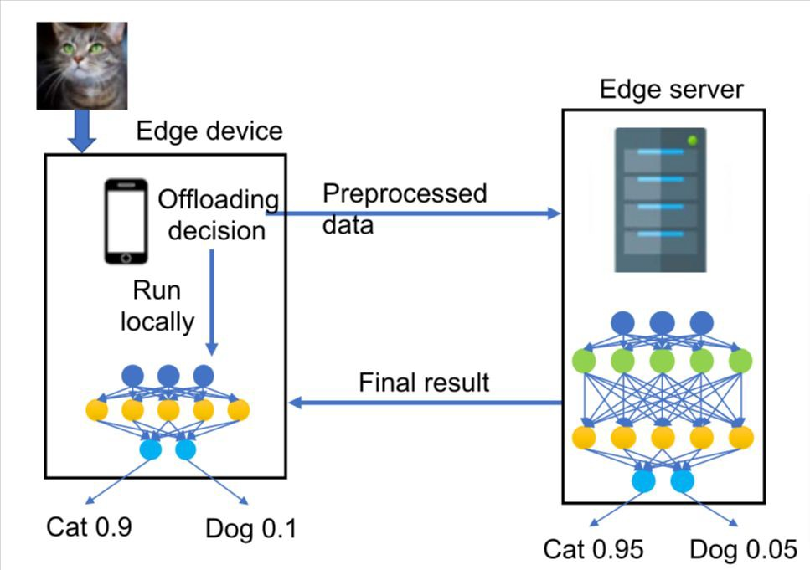
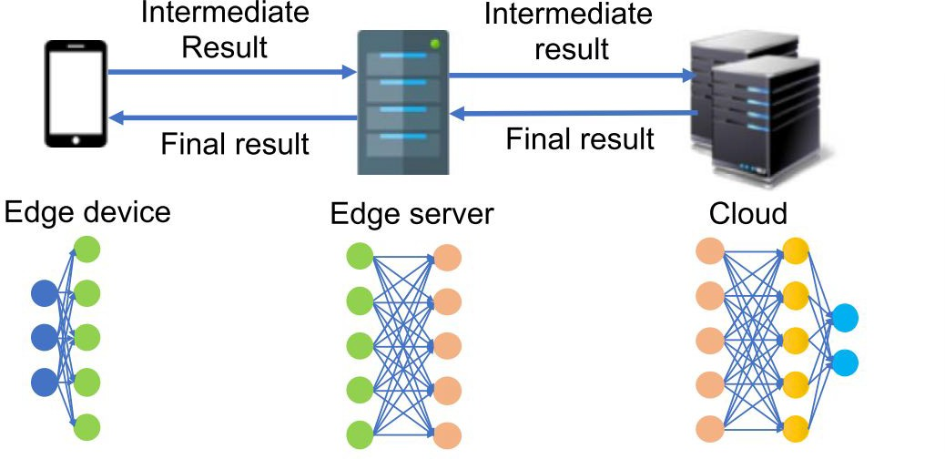
How to adapt ML for resource-constrained Edges?
Run ML on Dedicated Edge Servers
Model Partitioning

Slide 24
Outline
Brief introduction of machine learning
Executing ML tasks at Edge
Training ML models at Edge

Slide 25
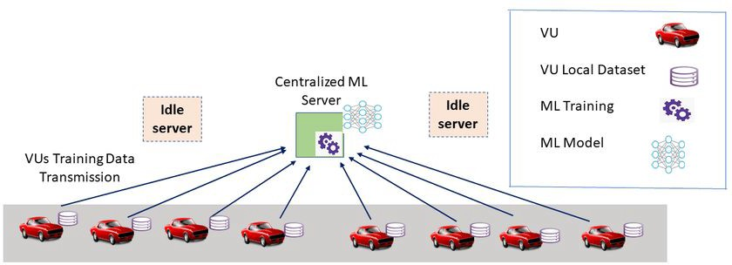
Cloud-based ML Training
Problems:
Take pretty long to transmit sensing data to cloud server
Take pretty long to train the ML model on centralized server

Slide 26
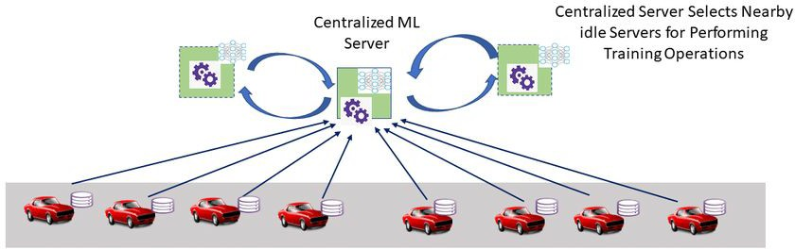
Cloud-based Distributed ML
To solve Problem #2, centralized ML server distributes training tasks on nearby servers

Slide 27
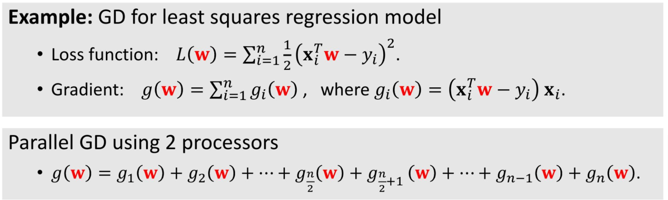
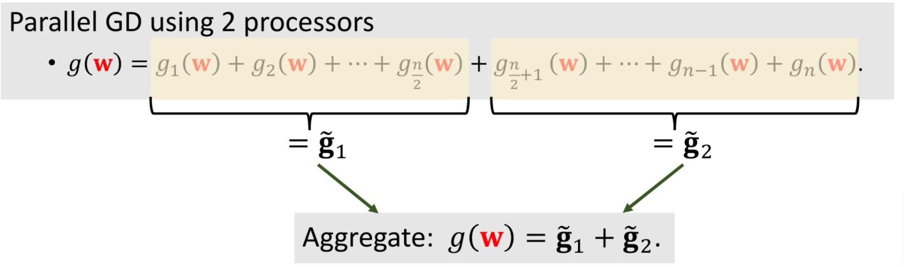
Recalling the previous example

Slide 28
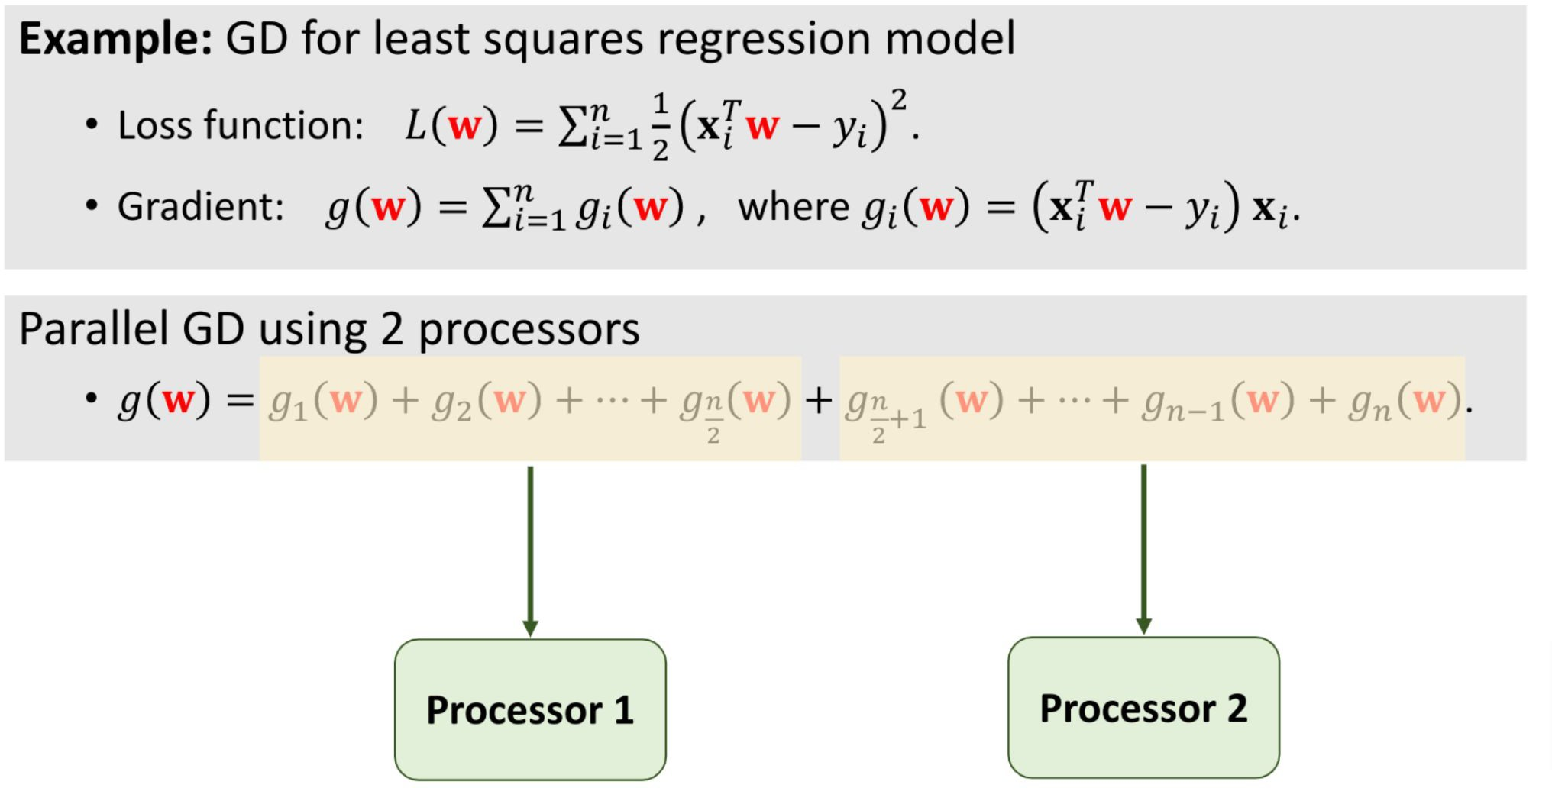
Parallel Gradient Descent

Slide 29
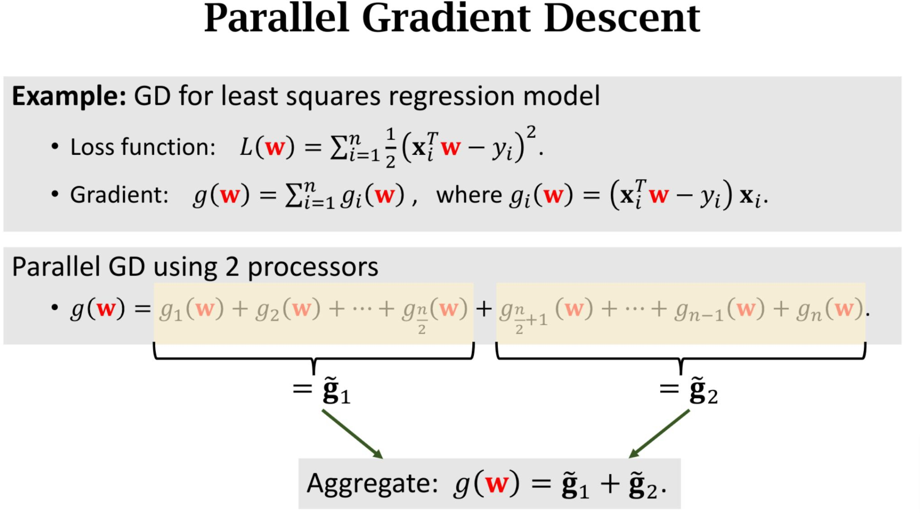
Parallel Gradient Descent

Slide 30
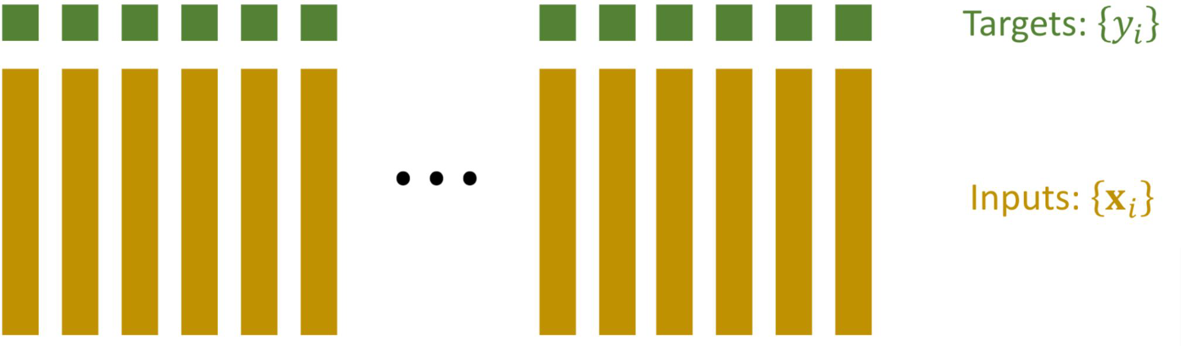
Distributed Machine Learning

Slide 31
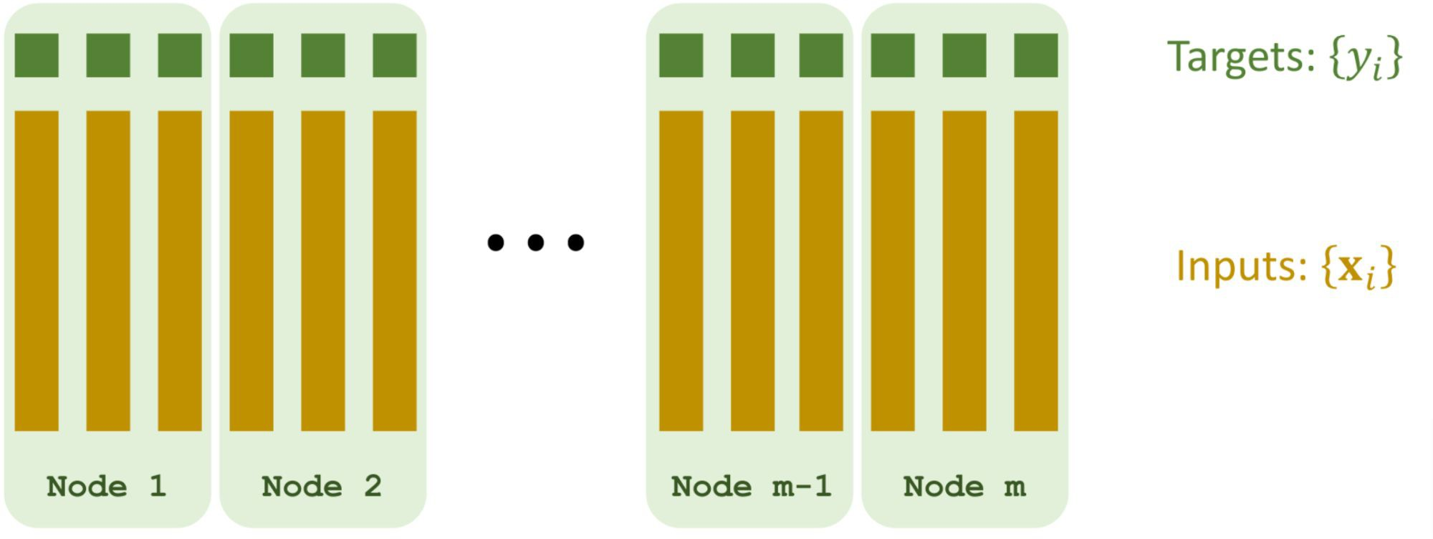
Distributed Machine Learning
Partition the data among worker nodes (each node has a subset of data)

Slide 32
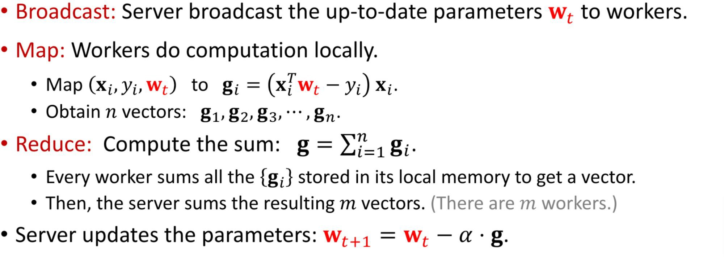
Distributed Machine Learning by Map-reduce

Slide 33
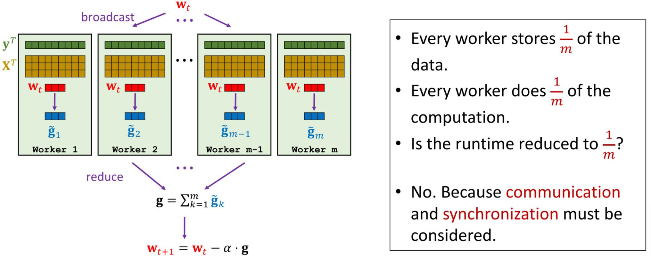
Distributed Machine Learning by Map-reduce

Slide 34
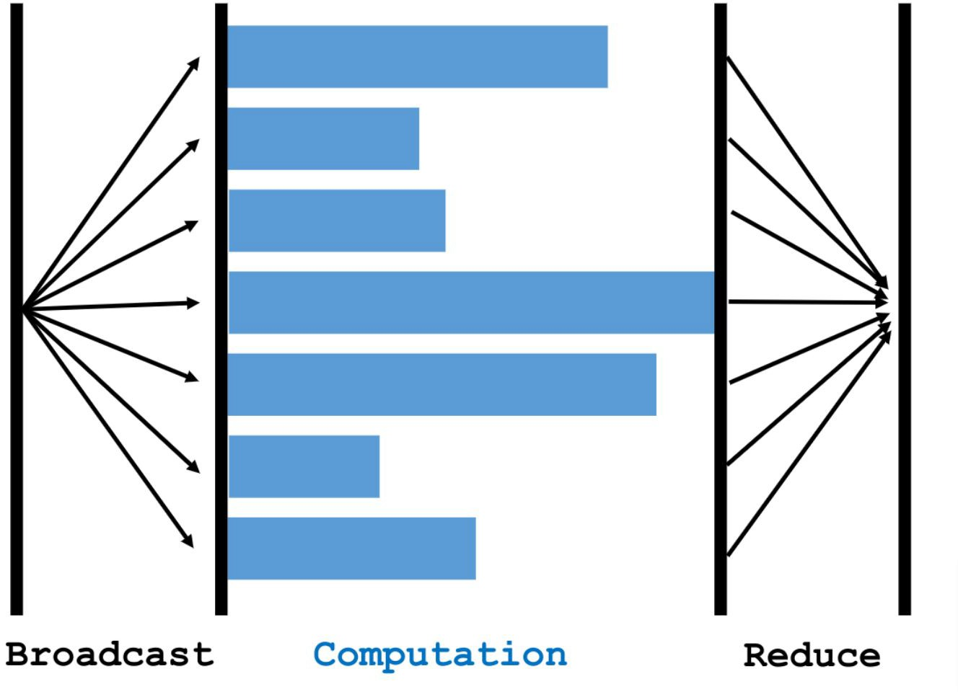
Bulk Synchronous
Slow Nodes: Straggler
Problem: low efficiency

Slide 35
Distributed Machine Learning by Parameter Server
Parameter Server was proposed by [1] for scalable machine learning
Characters: client-server architecture, message passing communication and asynchronous.
[1] Li MU et al. : Scaling Distributed Machine Learning with the Parameter Server, In OSDI, 2014

Slide 36
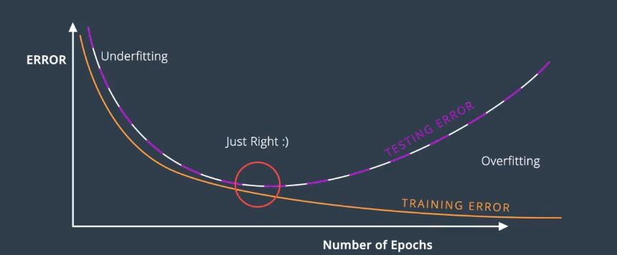
Epoch:
We often need to train the model multiple times over the dataset
Epoch: the number of complete passes through the training dataset.

Slide 37
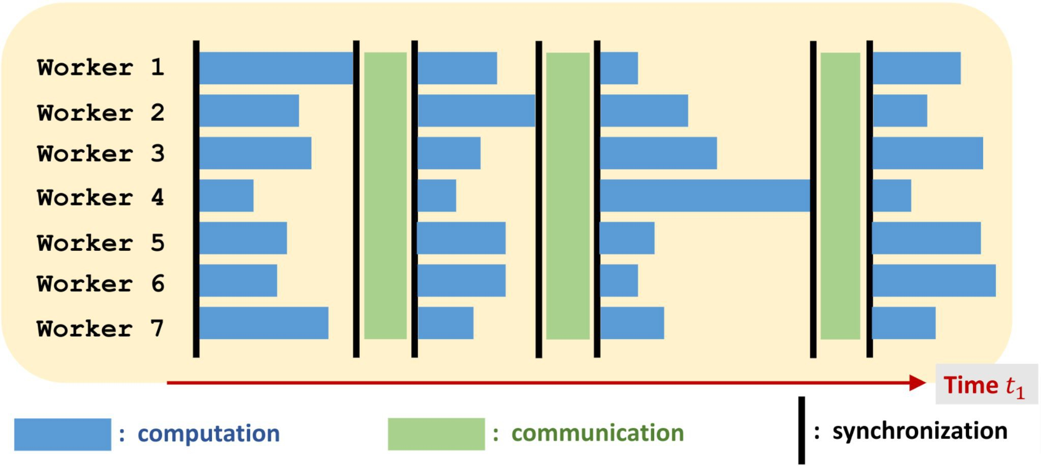
Synchronous Algorithm

Slide 38
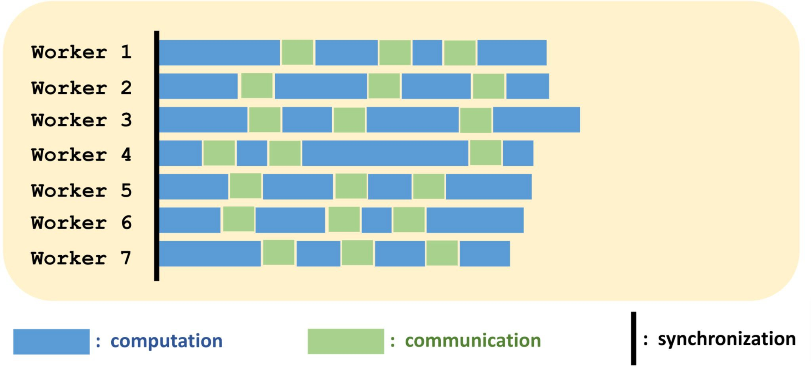
Asynchronous Algorithm

Slide 39
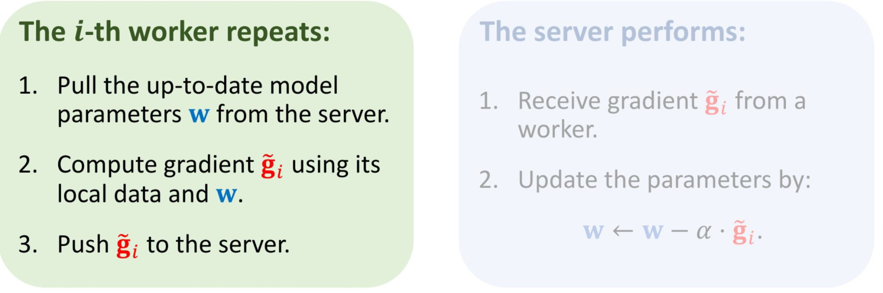
Asynchronous Gradient Descent

Slide 40
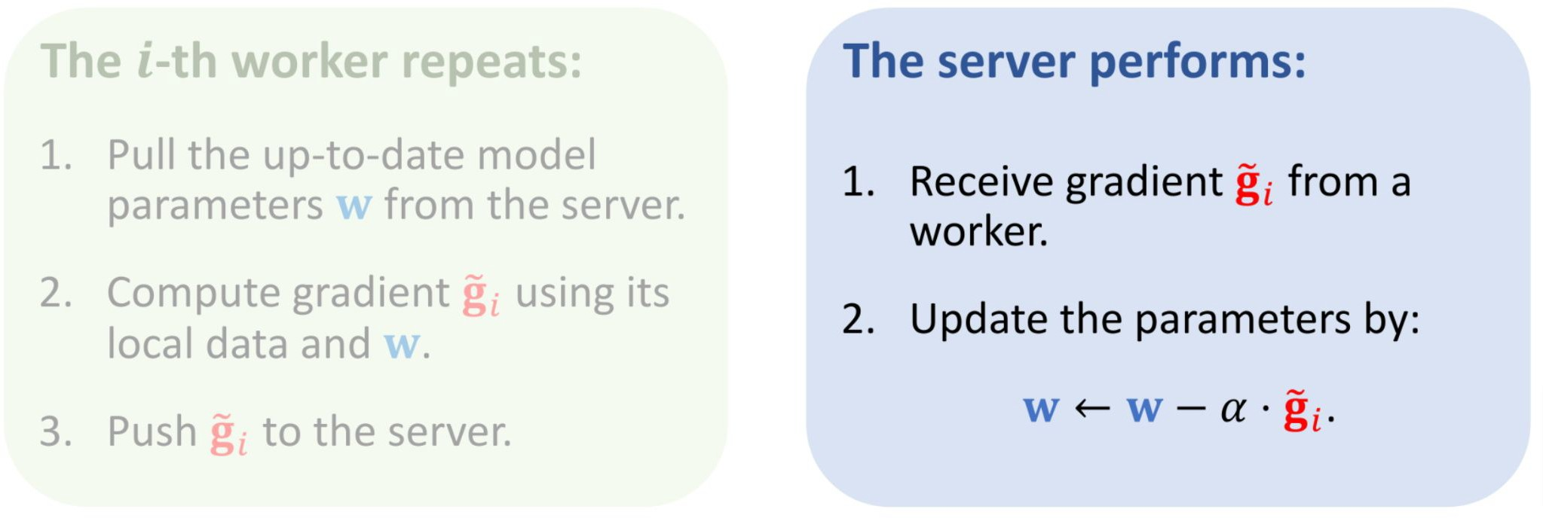
Asynchronous Gradient Descent

Slide 41
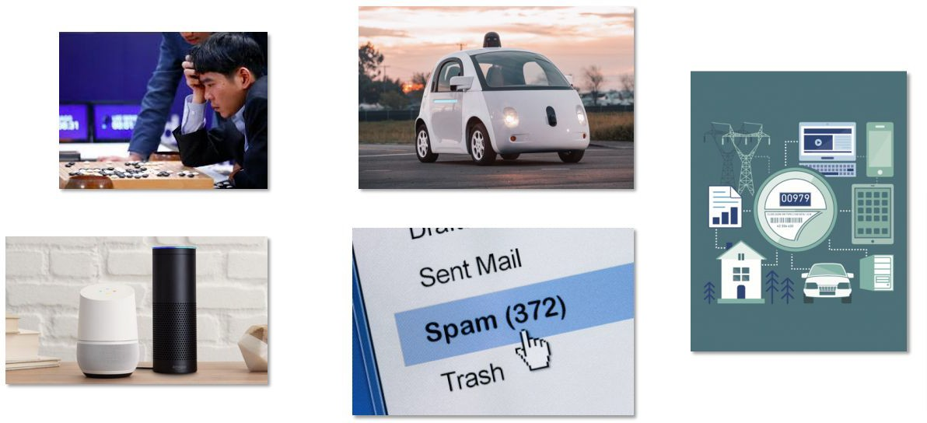
What’s wrong with cloud-based training?
The biggest obstacle to using advanced data analysis isn’t skill base or technology; it’s plain old access to the data --- Edd Wilder-James, Harvard Business Review

Slide 42
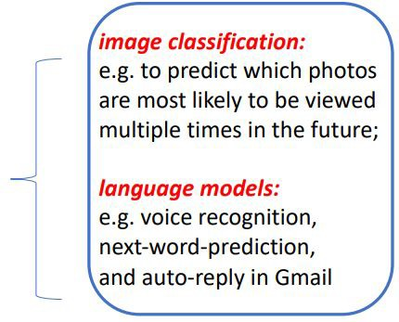

Two Main Problems
Privacy: photo/password/url/messages
Network Overhead
Solution: train a model locally and upload the model

Slide 43

Example
Next Word Prediction

Slide 44

Federated Learning Overview
Notes:
Federated learning: a large model is distributed to local models and ran and results aggregated to the global model. For further/final analysis/computation.

Slide 45

Federated Learning Overview

Slide 46

Federated Learning Overview

Slide 47
What is Federated Learning?
Federated Learning is a kind of distributed learning
How does Federated Learning different from traditional distributed learning?
Users have control over their device and data.
Worker nodes are unstable.
Communication cost is higher than computation cost.
Data stored on worker nodes are not IID (independent and identically distributed) (i.e. some nodes can contribute a lot more than others)
The amount of data on each node is severely imbalance.
Notes:
Federated learning is still a type of distributed learning but has some unique features, as shown above.

Slide 48


Distributed ML

Slide 49

Distributed ML
Notes:
3. →back propagation to update model weights (parameters).

Slide 50

FedAvg
Epoch

Slide 51

FedAvg

Slide 52


FedAvg Vs. Gradient Descent

Slide 53

Federated learning: Basics and application to the mobile keyboard

